Slide 1
Regional Governance for Human Rights and Development In Asia
Rafendi Djamin
Indonesian Representative to ASEAN Intergovernmental Commission on Human Rights (AICHR(
Human rights and Development in Globalized World Conference
Seoul National University, Seoul , 20 May 2013

Slide 2
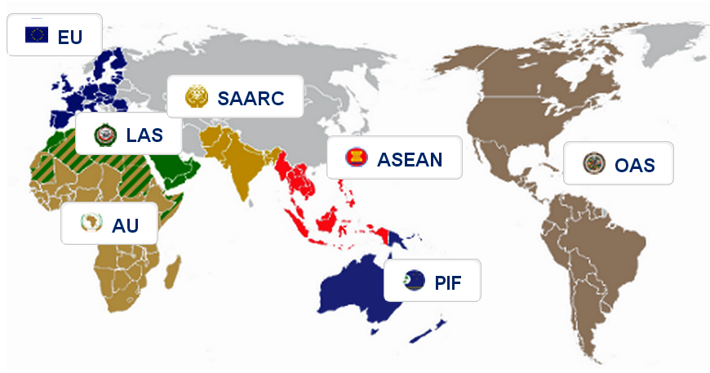
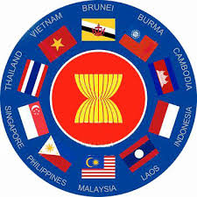

Picture : http://www.idea.int
ASEAN: Southeast Asia Nations, 1967
Population in 2011: 602,658,000
SAARC: South Asian Association for Regional Cooperation, 1985
Population in 2009: 1,600,000,000

Slide 3


SAARC (The South Asian Association for Regional Cooperation)
Established in 1985 (SAARC Charter of 1985)
8 members, 9 observers, 3 potential future members (China, Russia, Myanmar)
A socio-economic grouping with main purpose to "promote the well-being" of the people of SA
SAARC Charter of Democracy adopted in 2011
SAARC Social Charter adopted in 2004
SAARC Development Goals (SDGs) was setup in 2004 to achieve MDGs by 2015

Slide 4
SAARC Social Charter, 2004
Signed in Islamabad Summit in 2004
Envisages action in the areas of
  poverty alleviation
  health
  Education
  Education, Human Resource Development and Youth Mobilization
  Promotion of the status of women
  Promotion of the Rights and Well-being of the Child
  Drug de-addiction, Rehabilitation and Reintegration
The implementation by a National Coordination Committee or any national mechanism decided in each country.
SAARCH Social Charter

Slide 5
SAARC Social Charter, 2004
The National Committee
To facilitate the implementation of the SAARC Social Charter and monitor performance in achieving its goals.
Mandate: To coordinate, facilitate & monitor the implementation of the goals of the SAARC Social Charter; to coordinate with the National Committees of other SAARC Member States and consult

Slide 6
Human Rights in SAARC
Agreements, common action plans on Human Rights
SAARC Convention on Preventing and Combating Trafficking in Women and Children for Prostitution
SAARC Convention on Regional Arrangement for the Promotion of Child welfare in South Asia in SAARC.
Agreement on Food Security Resort and specific social issues

Slide 7
Human Rights in SAARC
Six countries of SAARC have NHRIs that assemble at Asia Pacific Forum as Members.
Cut crossing common problems: torture, trafficking, IDPs due to conflicts, refugees, right over resources, urban shelter and demolition, livelihood, VAW, death Penalty, and involuntary disappearances.
But NHRIs are not coming at common platform for a common understanding on the Human Rights at SAARC level.
NHRIs can monitor treaties and spotlight on the human rights issues in context of its new role in process of Human Rights Council of United Nations such as UPR.
SAARC will make demands on NHRIs Institution to come forward at SAARC level.
Source: Dr.Lenin,Dr.Mohan Lal

Slide 8
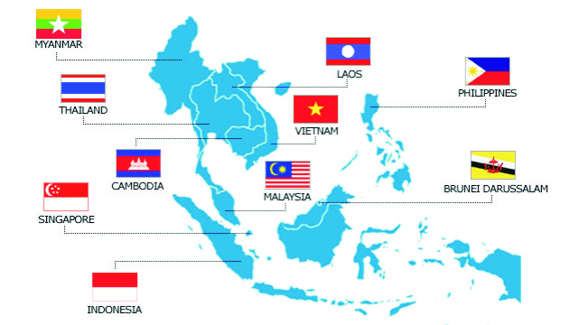
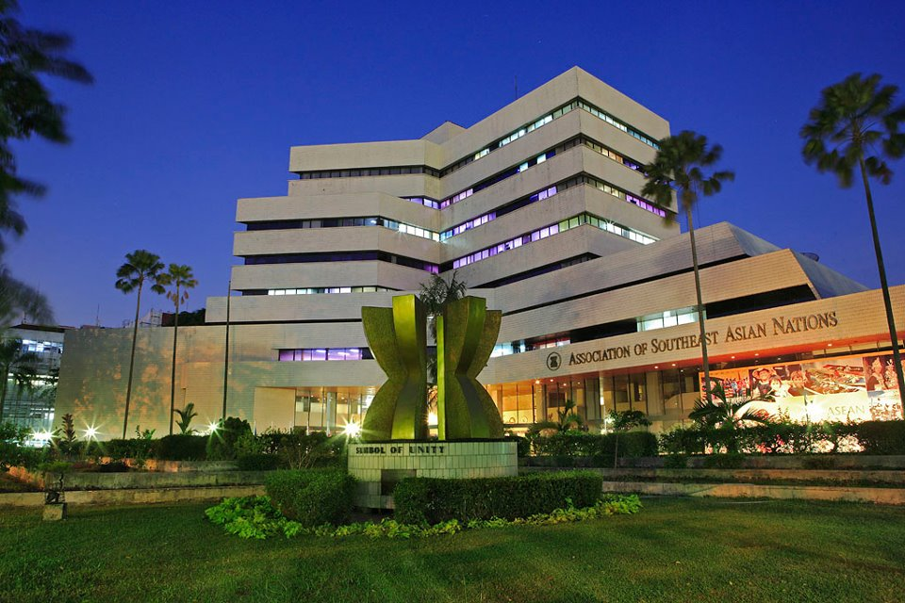
ASEAN (Association of the Southeast Asia Nations)
10 member countries
Established. 1967
ASEAN Charter 15 Dec 2008

Slide 9

ASEAN Community 2015
ASEAN Political-Security Community – peaceful processes in the settlement of intra-regional differences and it has the following components: political development, shaping and sharing of norms, conflict prevention, conflict resolution, post-conflict peace building, and implementing mechanisms
ASEAN Economic Community - creating a stable, prosperous and highly competitive ASEAN economic region in which there is a free flow of goods, services, investment and a freer flow of capital, equitable economic development and reduced poverty and socio-economic disparities in year 2020;
ASEAN Socio-Cultural Community - envisages a community of caring societies and founded on a common regional identity, with cooperation focused on social development aimed at raising the standard of living of disadvantaged groups and the rural population, and shall seek the active involvement of all sectors of society, in particular women, youth, and local communities

Slide 10
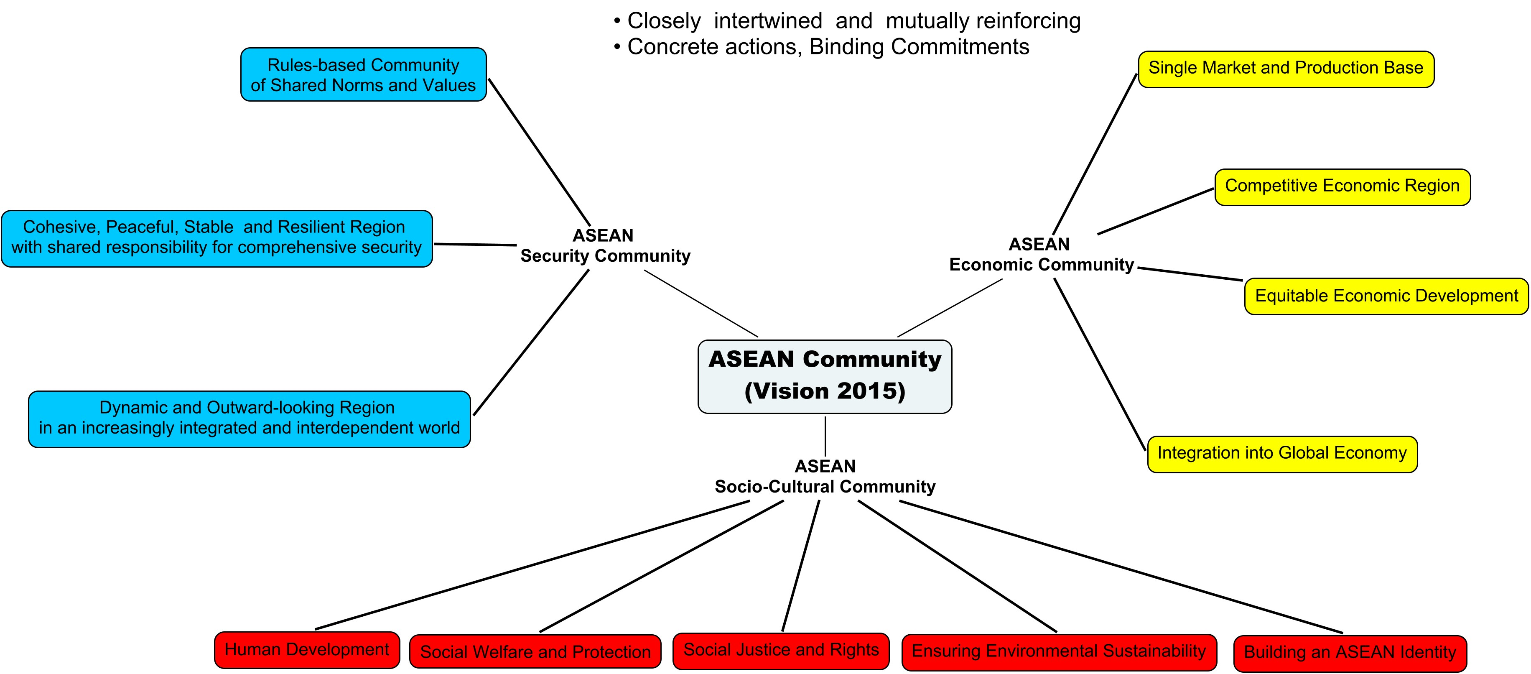

Slide 11

POLITICAL –SECURITY Blueprint
Rules based, shared norms and values
Cohesive, peaceful, stable, resilient with shared responsibility
Dynamic and Outward looking
ECONOMIC Blueprint
Single Market and production base
Competitive economic region
Equitable Economic development
Integration into global economy
SOCIO-CULTURAL Blueprint
Human Development
Social Welfare and Protection
Social justice and rights
Environmental Sustainability
ASEAN Identity
ASEAN Charter - One Vision, One Identity, One Caring and Sharing Community

Slide 12
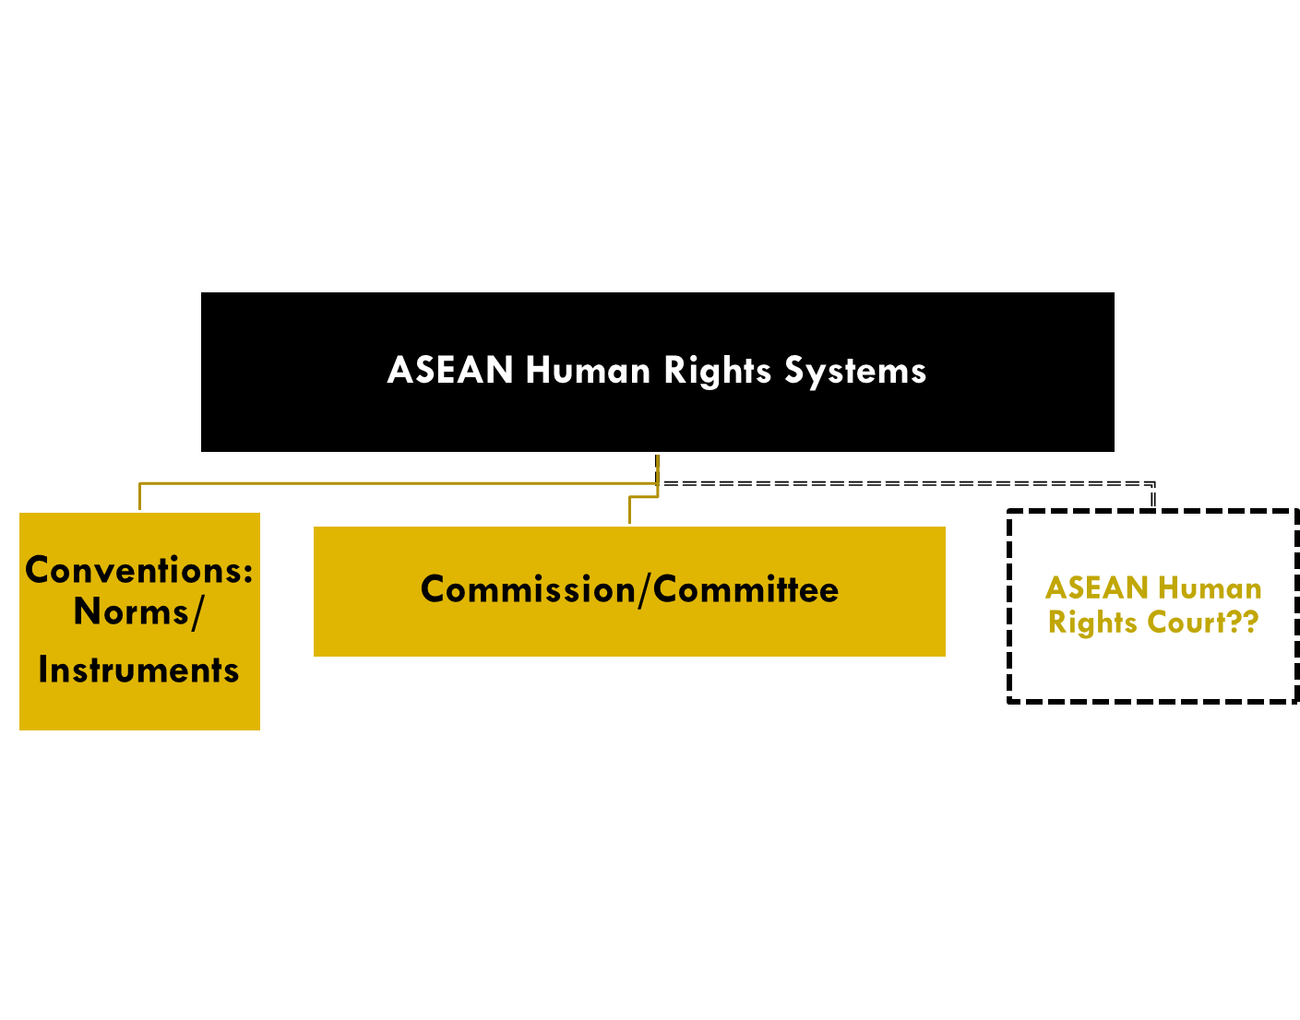
The 3Cs in Human Rights Architecture
AICHR 2009
ACWC 2010
ACMW 2008

Slide 13
1st C: “Commissions”
AICHR
ACWC
Created based on Article 14, Charter
Established: 23 Oct 2009
10 Representatives
14 Mandates
No individual complaint
Provide advises to ASEAN sectorial government upon request
Can obtain information on HR issues from Member States
Consult stakeholders
Submit Annual Report
Created based on SC Blueprint
Established: 7 April 2010
20 Representatives (Women Rights and Child Rights)
16 Mandates
No individual complaint
Provide advises to ASEAN sectorial government upon request
Consult CS, women, children
Advocate on behalf of women and children & encourage ASEAN Member States to improve their situation
Submit Annual Report

Slide 14
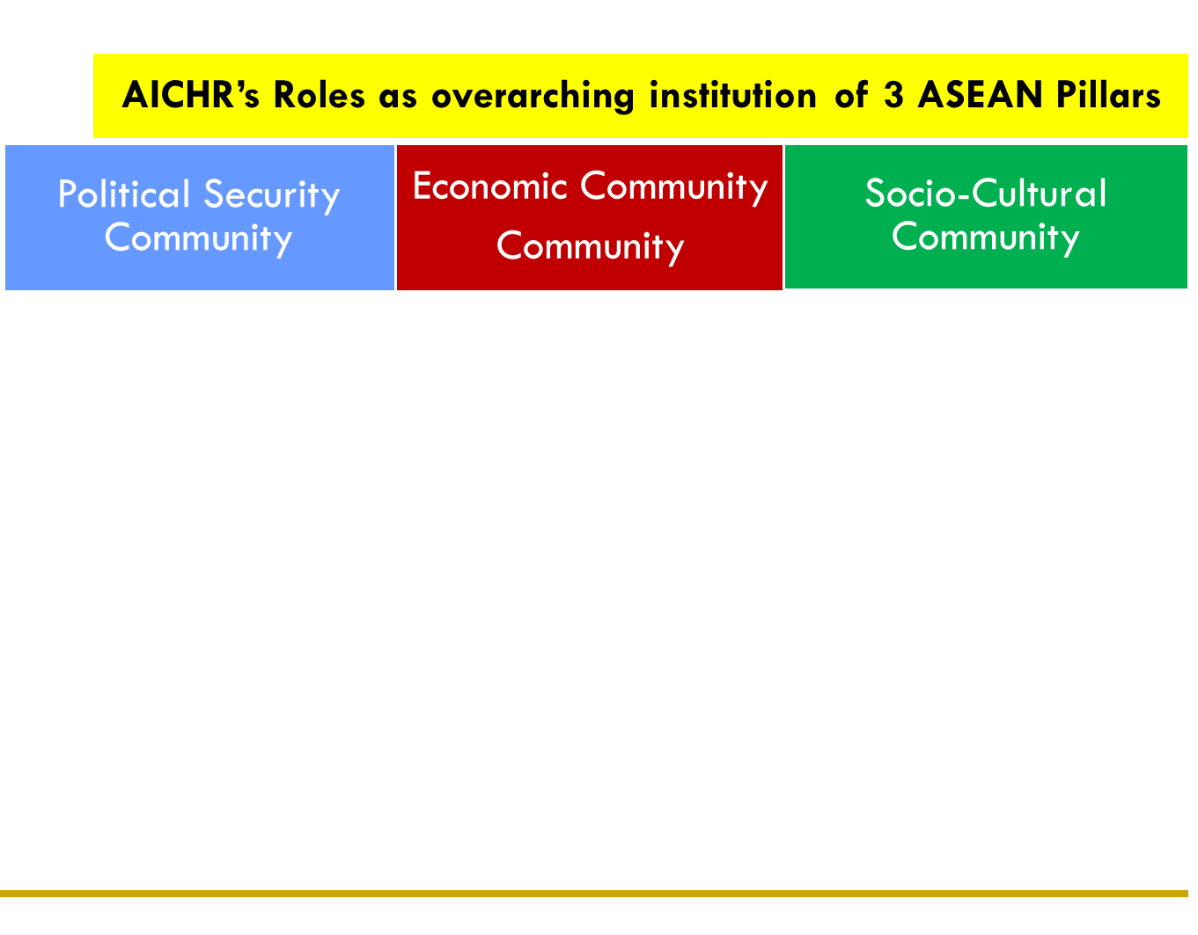
Trafficking in person
Economic & social human rights protection in the trade agreements between ASEAN nations & other parties, and amongst ASEAN nations
human rights and climate change
Human rights protection in the anti-terror policy of ASEAN nations
Protection of the human rights of women and children
Conflict prevention and gross violation of human rights (genocides, crimes against humanity, war crimes)
Social protection with human rights perspectives in the labor policies of ASEAN nations
Protection of Migrant Workers
Human rights in the national curriculum of ASEAN nations
Freedom of movement and right to work for the people of ASEAN nations
Human rights protection in the effort against non-traditional security threat
Protection of the rights of sex commercial workers, trans-gender, Male sex with Male (MSM)

Slide 15
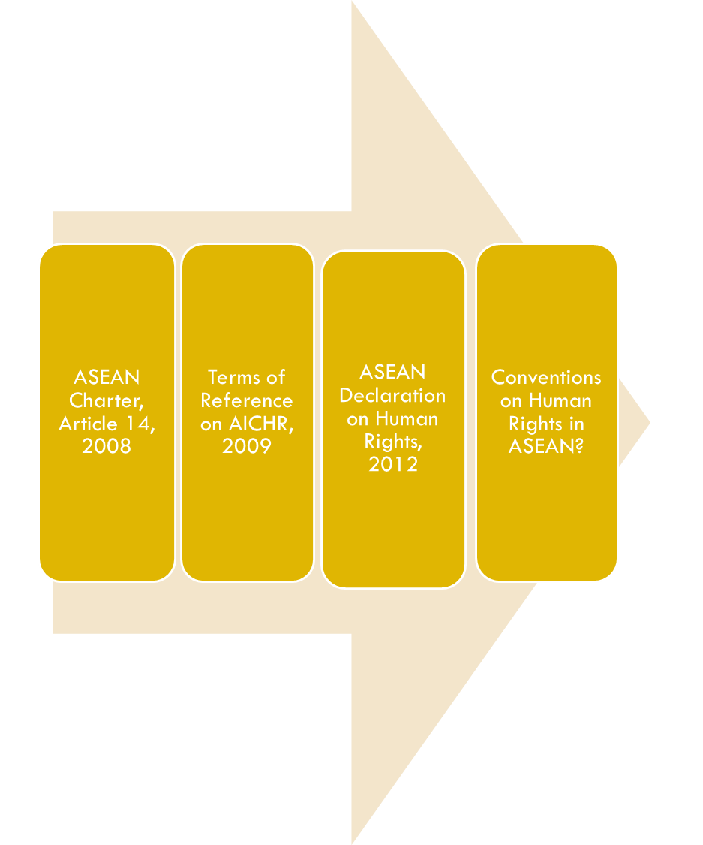
2nd C: “Convention”: Standard-Setting Scenario
ASEAN HUMAN RIGHS DECLARATION Is adopted on 18 November 2012, during the 21st ASEAN Summit
Is the effort to universalize human rights at the regional level, or regionalize the universal political commitment of human rights

Slide 16
ASEAN HUMAN RIGHTS DECLARATION (AHRD), 2012
PHNOM PENH STATEMENT with signatures of ASEAN Leaders, Article 3:
“REAFFIRM further our commitment to ensure that the implementationof the AHRD be in accordance with Our commitment with the Charter of the United Nation, the Universal Declaration of Human Rights, The Vienna Declaration and its Prograam of Action, and other international human rihts instrument to which ASEAN Members Sttes are parties,as well as relevant ASEAN declarations and instruments pertaining to human rights”

Slide 17
ASEAN HUMAN RIGHTS DECLARATION (AHRD), 2012
RIGHT TO DEVELOPMENT
Article 35
“ The right to development is an inalienable human right by virtue of which every human person and the peoples of ASEAN are entitled to participate in, contribute to, enjoy and benefit equitably and sustainably from economic, social, cultural and political development. The right to development should be fulfilled so as to meet equitably the developmental and environmental needs of present and future generations. While development facilitates and is necessary for the enjoyment of all human rights, the lack of development may not be invoked to justify the violations of internationally recognised human rights.”

Slide 18
ASEAN HUMAN RIGHTS DECLARATION (AHRD), 2012
Article 36
“ ASEAN Member States should adopt meaningful people-oriented and gender responsive development programmes aimed at poverty alleviation, the creation of conditions including the protection and sustainability of the environment for the peoples of ASEAN to enjoy all human rights recognised in this Declaration on an equitable basis, and the progressive narrowing of the development gap within ASEAN.”

Slide 19
ASEAN HUMAN RIGHTS DECLARATION (AHRD), 2012
Article 37
“ ASEAN Member States recognise that the implementation of the right to development requires effective development policies at the national level as well as equitable economic relations, international cooperation and a favourable international economic environment. ASEAN Member States should mainstream the multidimensional aspects of the right to development into the relevant areas of ASEAN community building and beyond, and shall work with the international community to promote equitable and sustainable development, fair trade practices and effective international cooperation.”

Slide 20
Thank you!

Slide 21
Contact
Email: rafendidjamin@gmail.com
Tweeter: @IndoAICHR

